Slide 1
QOC (Quote On Cloud)
Simple, Fast, Brilliant.

Slide 2
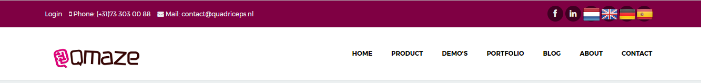
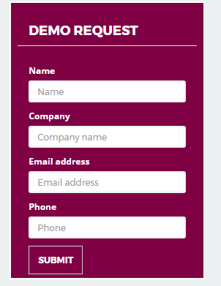
`
Quote On Cloud
Digitization of Office Process
Increase Your Sales
Right First time clean Quotes
Never Loose your Key Contact & Customers
Business Transformation
Build your inventory on Click
Happy Customers
Quick Demo

Slide 3
Login Page
Company Name | Yocanai
UserName | Mice
Password | ****
Login
Forgot Pwd
Login – should login with user Role, and show landing page as defined in next tab.
Forgot Pwd – Should navigate to a new page, which should automatically say –”user ID & pwd is sent to your registered email ID. Also, a link below for user to facilate change in pwd. (current pwd & new passwd re-entered (basic pwd policy)
Role – (User/ Admin) – Admin should define at time of new user creation as Admin OR Agent. Also add agent email ID, pwd, login name, company name etc.

Slide 4
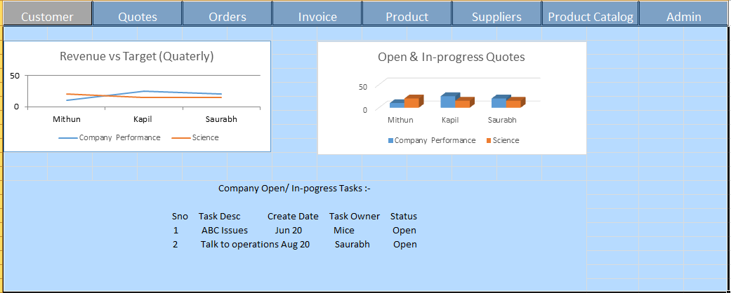
User landing page on login
Revenue vs Target is fetched from –
Revenue is sum of all order Invoice value in a calendar month.
Target is a updated by Admin – in Admin tab wherein he specifies target per month.
Open & In-progress Quotes –
Based on Agent’s updated, open & In-progress Quotes as saved from UI.

Slide 5
Cont..
Company Wide Open/ In-progress Tasks –
Based out of every MoM, company meetings, this feature enables Admin & users to add Open/ In-progress/ Closed tasks. (from independent table, no link to other tables).
TaskID taskName Status (open/in-progress/Close) Date TaskOwner
<Above data have nothing to with quote/ order/ details..its only task details>
Tabs on tab are self explanatory

Slide 6
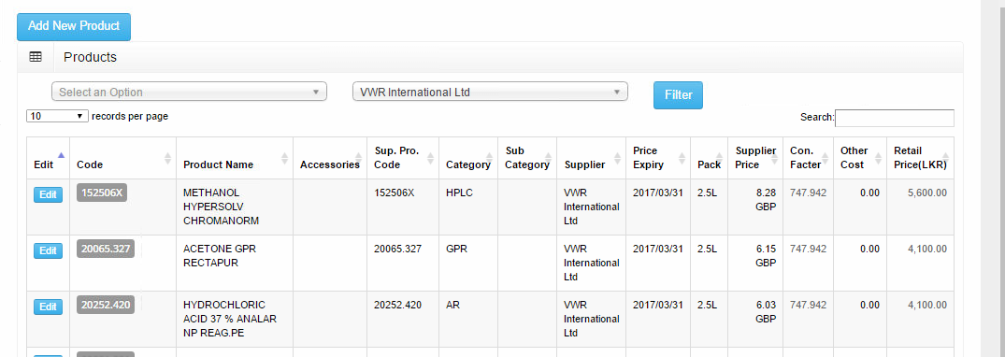

Customer Tab –
For Customer, Quote & Product, the landing page will contain –
Records wise data as below. (sample screen as below).
On click of ‘Add new xxxx’ a new pop-up will open to capture user inputs.

Slide 7
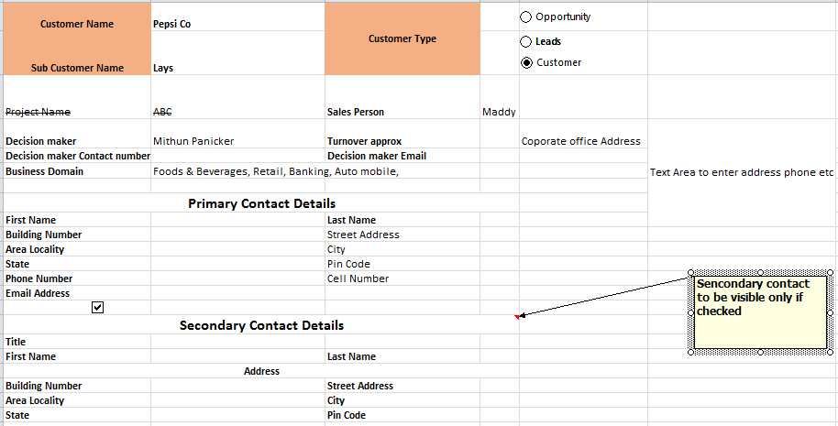
Customer Tab – The pop-up for ‘Add new Customer is cut into 3 parts, below is first part…
Customer name is free text, along with exist value fetch from drop-down. & cust. ID in DB.
Sub Customer Name- this is again a LISTBOX (allow to create new or select from drop-down
Customer Type- Opportunity, Lead, Customer as – radio-button to be selected.
Sales Person – Drop-down with list of users/ sales person

Slide 8
Cont…
Decision Maker- This is LOV from drop-down with Admin name(s)
Turn-over Appx (LPA) – String, show LPA in bracket beside attribute name.
Corporate office Address – Free text (2000 char)
Decision Maker contact number- String (no validation)
Decision Maker Email - String (no validation)
Business Domain – LOV (Information Technology, Gaming, Network Services, Engineering Services, Retail, WholeSale, Market Research, ITES/BPO, Software Services, Legal, Financial Services, Healthcare), Food & Beverages, Banking.
Primary Contact details – As listed in snippet, Also a checkbox if enabled, will enable Secondary Contact details.
Notes – Free text. (Put dateTimeStamp automatically, while saving notes.
Last Contacted Date, Next Appoint Date, Follow-up Sequence (number), Lead type (Drop down - Neutral, Good, Very good, Rejected, closed business) – as new attributes shown in image.
Existing Quotes & Orders – to show recent 5 list of Quote/ OrderID, desc &status.
Rest available in paging/ scroll (what ever is fast)
Customer Sites – to publish customer sites (ALL) in below grid.
Paging/ scroll (which ever is fast)?
- Save should save ALL changes on this page. & Quote should carry All attributes as required in Quote tab.s

Slide 9
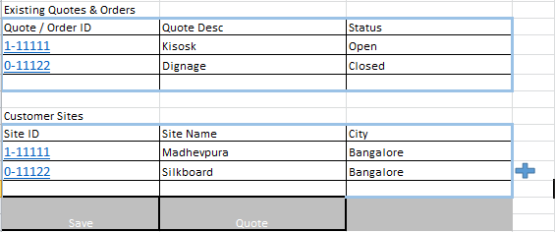
Cont…
Data fetch from Order table of specific customer
Data entered through this page & fetched in next login for given customer

Slide 10
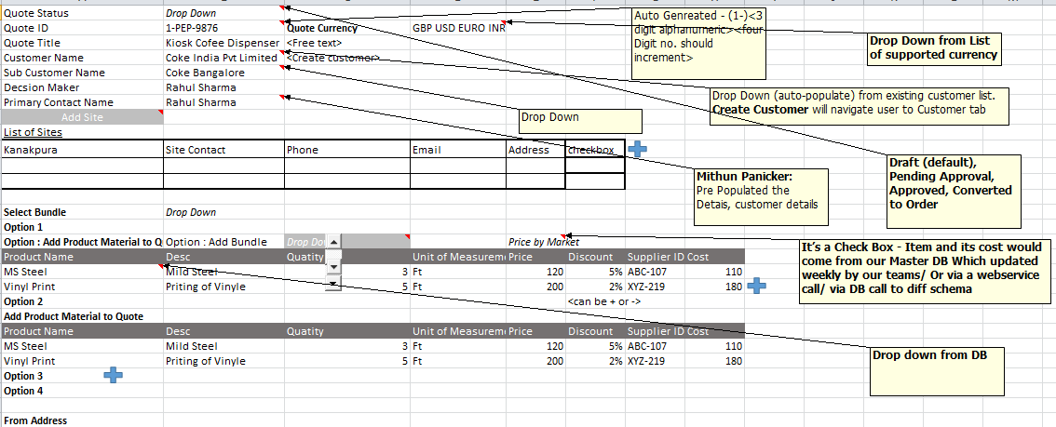
Quote Tab have 3 sub-tabs as – Generate Quote, Quote Cover Letter, Quote Summary
For Quote tab - The landing page will contain – Records wise data.
On click of add new Quote, a pop-up with as above will open.

Slide 11
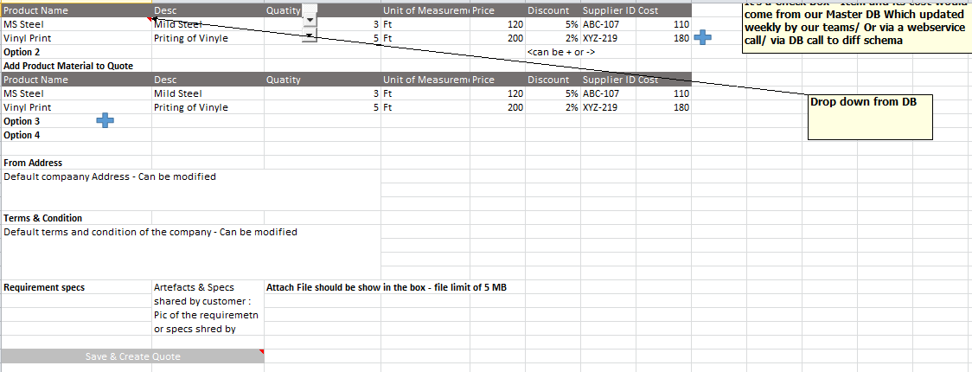
Cont..
This sign is a function to add a new line in that row.
Columns to add –
Quote Expiry Date – (Auto-populate as 1 month)
Quote create Date.
Replace Cost with ‘Price’
In option – Add a column as ‘GST/ Tax applied’
Save & Create Quote – should navigate to ‘Quote cover letter’ tab.
3 tabs inside Quote tab –
1.) Quote Creation. 2.) Quote Cover Letter 3.) Quote Summary

Slide 12
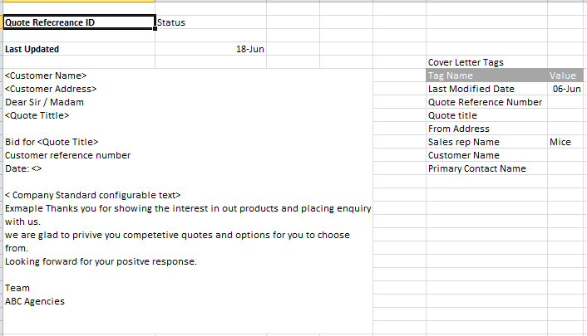
Quote cover letter tab (Sub-tab in Quote tab)
Changes done here
1
Changes reflect here automatically
2

Slide 13
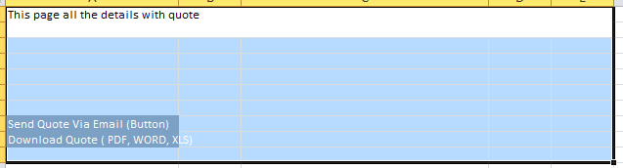
Quote Summary tab (Sub-tab in Quote tab)
User should be able to select .pdf, or .word, or .excel or (as many possible format) in which Quote should be generated.
Download Quote Email Quote
Download Quote – Should download quote in local
Email – email quote with quote cover letter in email body

Slide 14
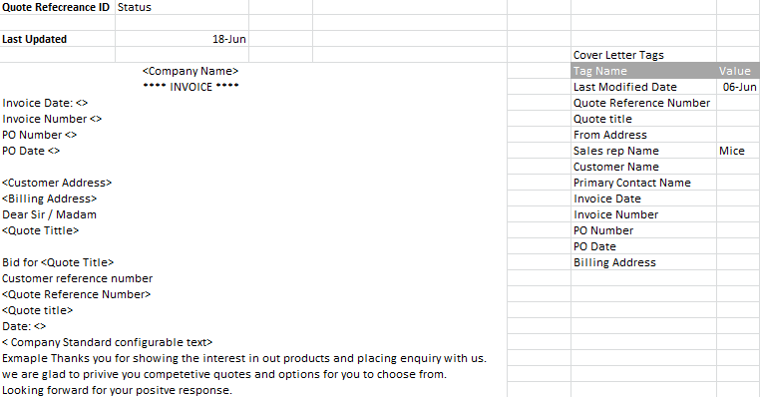
Order & Invoice Tab
Changes done here
1
Changes reflect here automatically
2

Slide 15
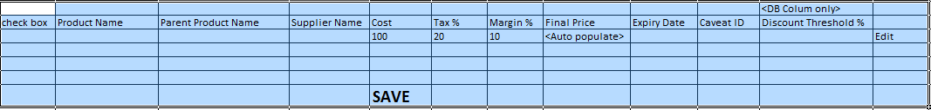
Products Tab-
Actual fields of Product as below

Slide 16
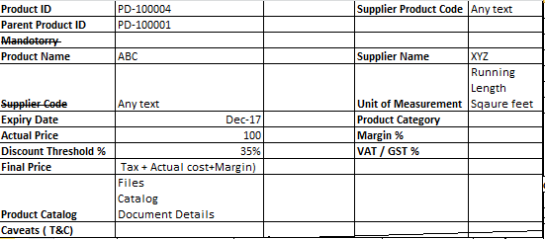
Cont…
On Click of Add new Product a pop-up should appear as below –
The details required are in below format (distributed over screen)

Slide 17
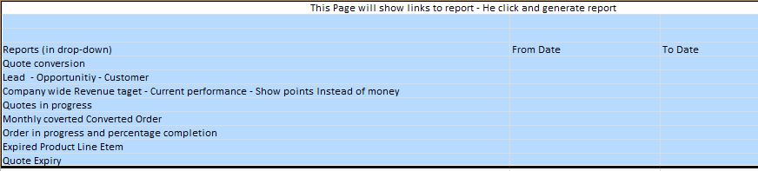
Reports
Report should be viewable on screen in – pie chart, bar graph (3-4 formats)
On screen View Download (buttons)

Slide 18
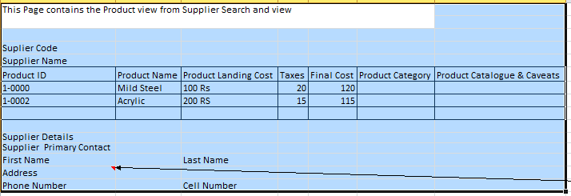
Supplier View Tab
Below view is a search based on Supplier Name, Supplier Product -> to fetch product details –

Slide 19
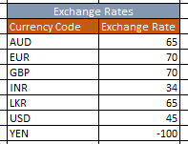
Admin tab (for Admin role)
User create & Password reset
Bulk load of Customer
Bulk load of Quote
Bulk load of Product
Exchange Rate – (User can update in below)

Slide 20
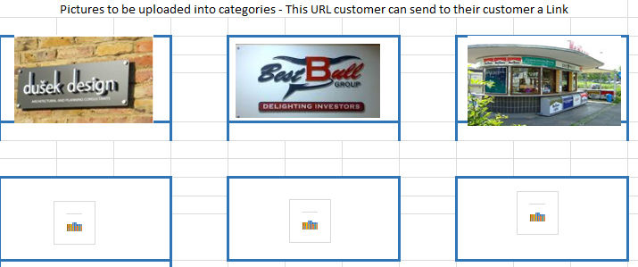
Product Catalogue – Images to be uploaded (as below)
Product Catalogue –
To be used by User/ Admin to share there product catalogue to NEW customers for marketing. The images & videos should be uploaded/ updated here.

